Slide 1
Ad Standards
Ad Standards is an industry funded independent complaints handling body
Promotes consumer and government confidence in advertising standards
The Community Panel looks at complaints against advertisements across a variety of industry Codes and Initiatives

Slide 2
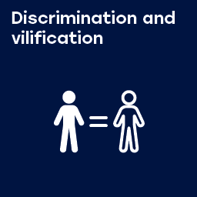
Section 2.1 – Discrimination and vilification
Advertisements shall not portray people or depict material in a way which discriminates against or vilifies a person or section of the community on account of race, ethnicity, nationality, gender, age, sexual preference, religion, disability, mental illness or political belief.
Notes:
Low level of complaints 2018 stats > 6 cases

Slide 3
Key themes
Advertisements that feature nudity or sexual themes are often complained about. Whether it features older or younger people.
Disparaging comments about older people.
Playing on stereotypes of older people.
Advertising products or services for the elderly.

Slide 4
241/05 – One Centre
Notes:
241/05 – One Centre – TV - UPHELD

Slide 5
Lumen - 0125/19
Notes:
0125/19 – Lumen – Billboard – DISMISSED

Slide 6
Hayeswinkle – 0542/16
Notes:
0542/16 – Hayeswinkle – Print - UPHELD

Slide 7
0469/18 – Bushells
Notes:
0469/18 – Bushells Tea – TV – DISMISSED

Slide 8
0330/18 – Australian Pork
Notes:
0330/18 – Australian Pork – TV - DISMISSED

Slide 9
0213/16 – Specsavers
Notes:
0213/16 – Specsavers – TV - DISMISSED

Slide 10
0422/13 – Just Cremations
Notes:
0422/13 – Just Cremations – Outdoor – DISMISSED

Slide 11
0354/15 – Freedom Aged Care
Notes:
0354/15 – Freedom Aged Care – TV - DISMISSED

Slide 12
0163/17 – Helping Hand Aged Care
Notes:
0163/17 – Helping Hand Aged Care – TV - DISMISSED

Slide 13
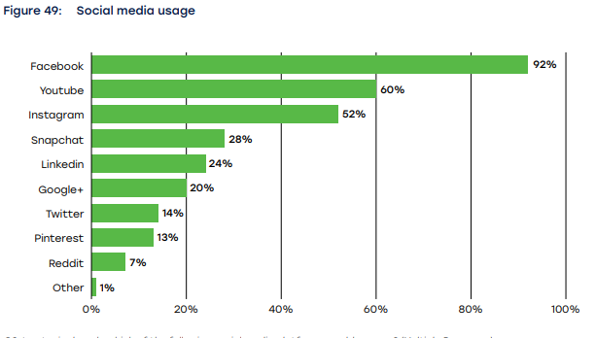
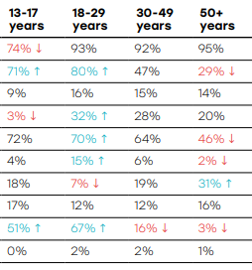
Social media usage

